Slide 1

Computer Architecture Project 1
Group members and marks-
Uday Teja Bandaru (utb220000)
Dibyanshi Singh (dxs210139)
100/100

Slide 2
CPI (CYCLES PER INSTRUCTIONS)

Slide 3
Calculating the CPI-
Configuration- TimingSimpleCPU, 128 L1D, 128 L1I, 1mb L2C, L1Dsa=2, L1Isa=2, L2sa=1, Cacheblocksize=64
From the formula and values, use configuration parameter as above and calculate the CPI for each benchmark by following equation.
CPI=1+ (IL.miss_num+DL.miss_num)x6+L2.miss_numx50
-------------------------------------------------------------
Total Inst num

Slide 4
Calculating the CPI values for simpleCPU for all 5 benchmarks with the configuration- 128kb, 128kb, 1mb, 2, 2, 1, 64
Benchmark | Configuration | Sim_Inst | DL1_M | IL1_M | L2_M | CPI
429.mcf | 128_128_1M_2_2_1_64 | 500000000 | 10225987 | 676 | 6552130 | 1.777932956
401.bzip2 | 128_128_1M_2_2_1_64 | 500000000 | 4027264 | 954 | 2743212 | 1.322659816
456.hmmer | 128_128_1M_2_2_1_64 | 500000000 | 197712 | 1330 | 7038 | 1.003092304
458.sjeng | 128_128_1M_2_2_1_64 | 500000000 | 8422662 | 2774 | 8380875 | 1.939192732
470.lbm | 128_128_1M_2_2_1_64 | 500000000 | 7161899 | 546 | 7153101 | 1.80125944

Slide 5
Other cpu-DerivO3CPU
Ben-marks | Configuration | Sim_Inst | DL1_M | IL1_M | L2_M | CPI
401 | 128kB_128kB_1M_2_2_1_64 | 500000005 | 5431687 | 1487 | 2745189 | 1.339717
429 | 128kB_128kB_1M_2_2_1_64 | 500000003 | 23204229 | 1088 | 6557472 | 1.934211
456 | 128kB_128kB_1M_2_2_1_64 | 500000005 | 292811 | 2306 | 7415 | 1.004283
458 | 128kB_128kB_1M_2_2_1_64 | 500000003 | 8462206 | 6881 | 8384814 | 1.94011
470 | 128kB_128kB_1M_2_2_1_64 | 500000000 | 7166422 | 875 | 7153392 | 1.801347

Slide 6
Tradeoffs-
1.Increase in cache block size, decrease the miss numbers, but with small cache sizes, the effect is not prominent
2.For low Cpi values, set associativity is proportionally dependent on cache size, when other parameters are constant.
3.Increase in cache sizes, decrease the miss numbers and result in low Cpi value, when all other parameters are constant.

Slide 7
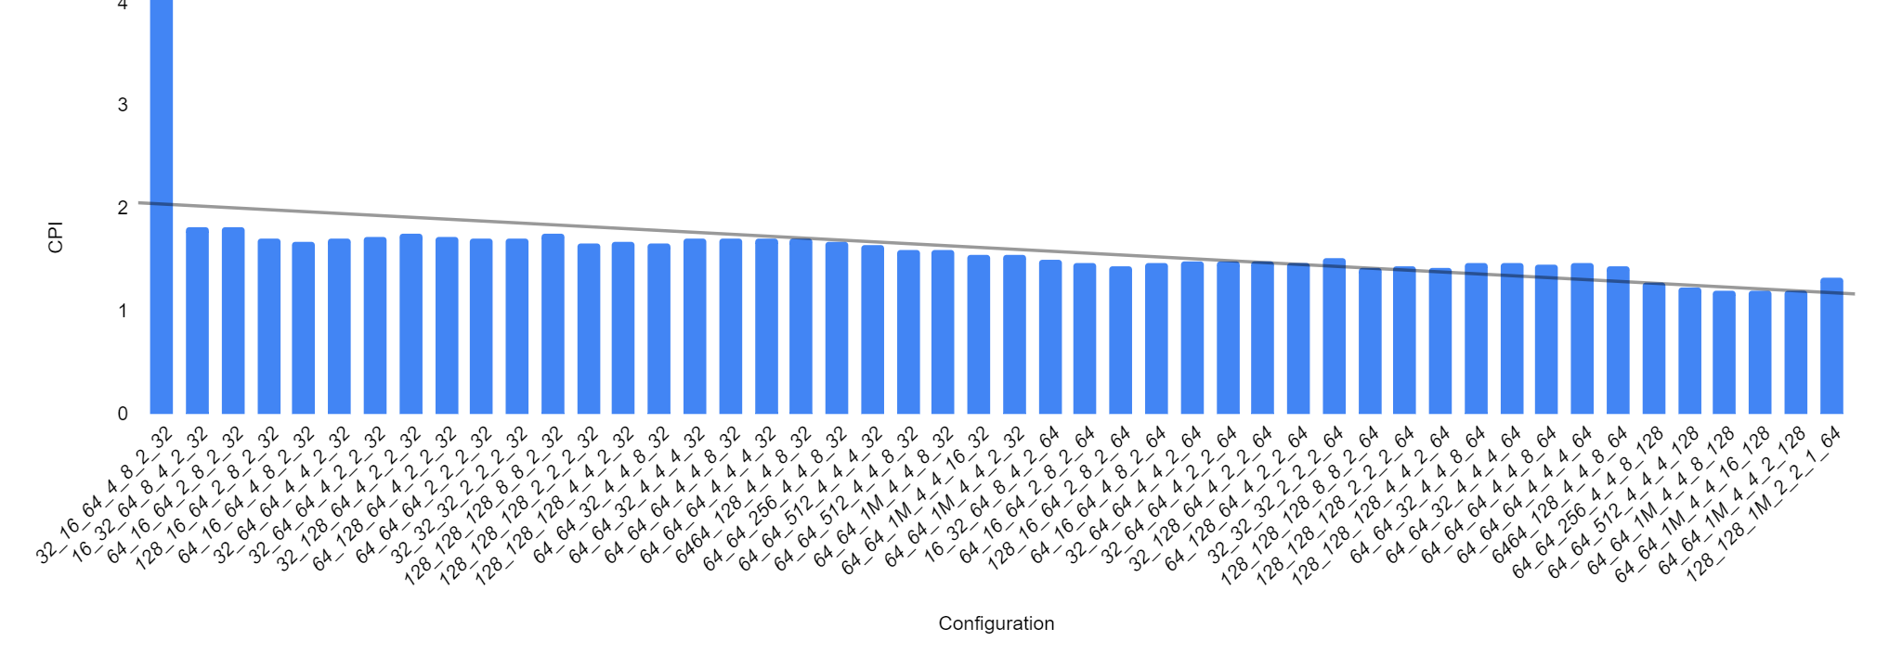
Defining lowest cpi value and configuration for each benchmark 401.bzip2
Lowest CPI Value-1.19657194
64kb 64kb 1mb 4 4 16 128

Slide 8
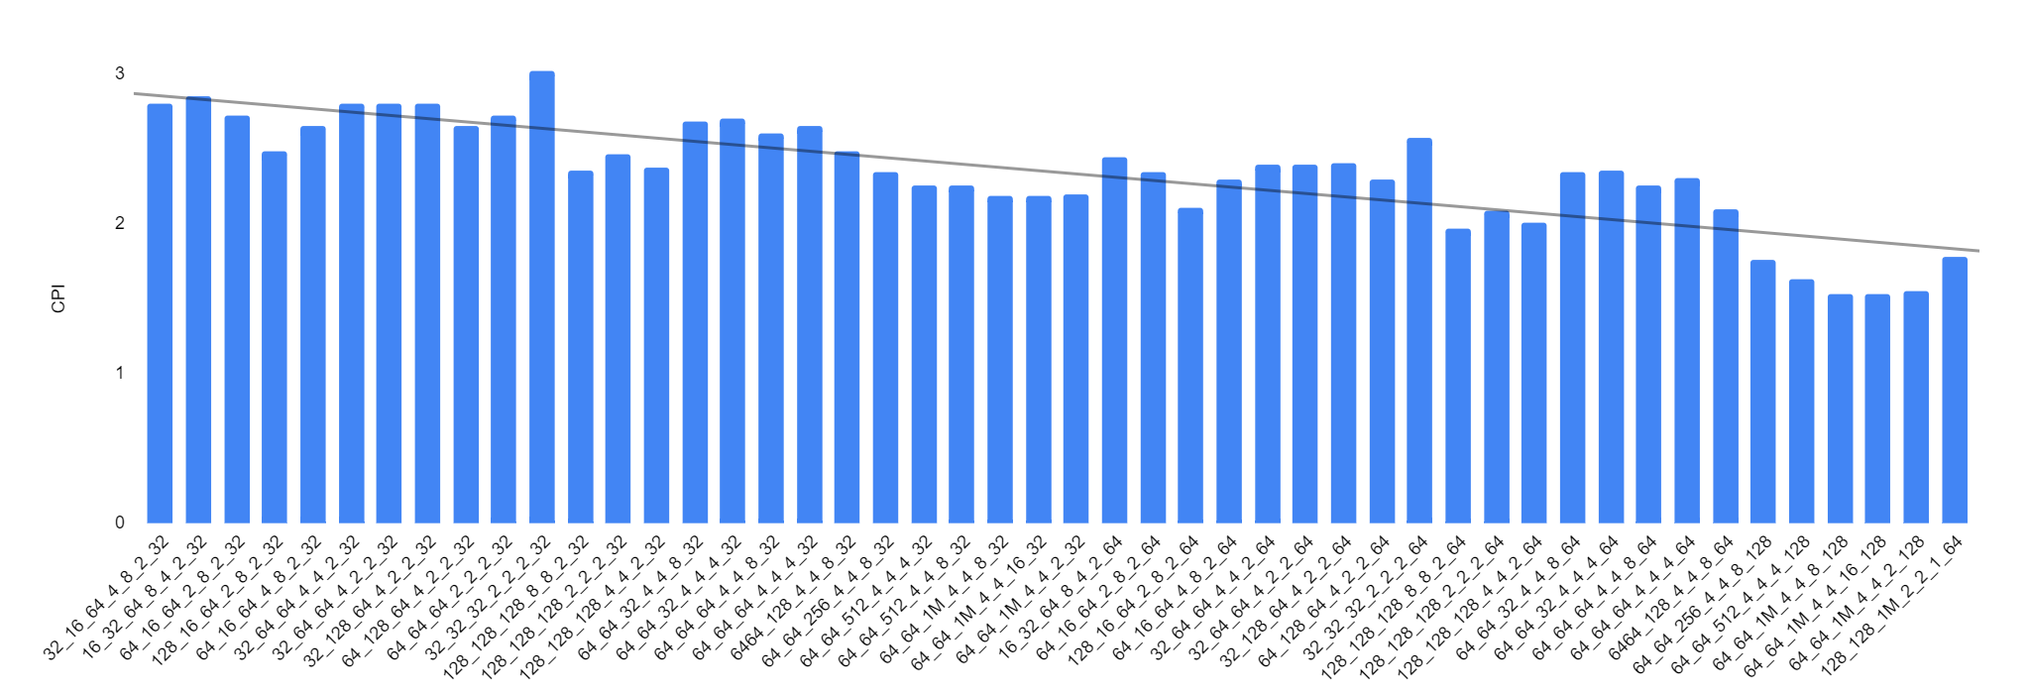
429.mcf
Lowest CPI value-1.533195416
64kb 64kb 1mb 4 4 16 128

Slide 9
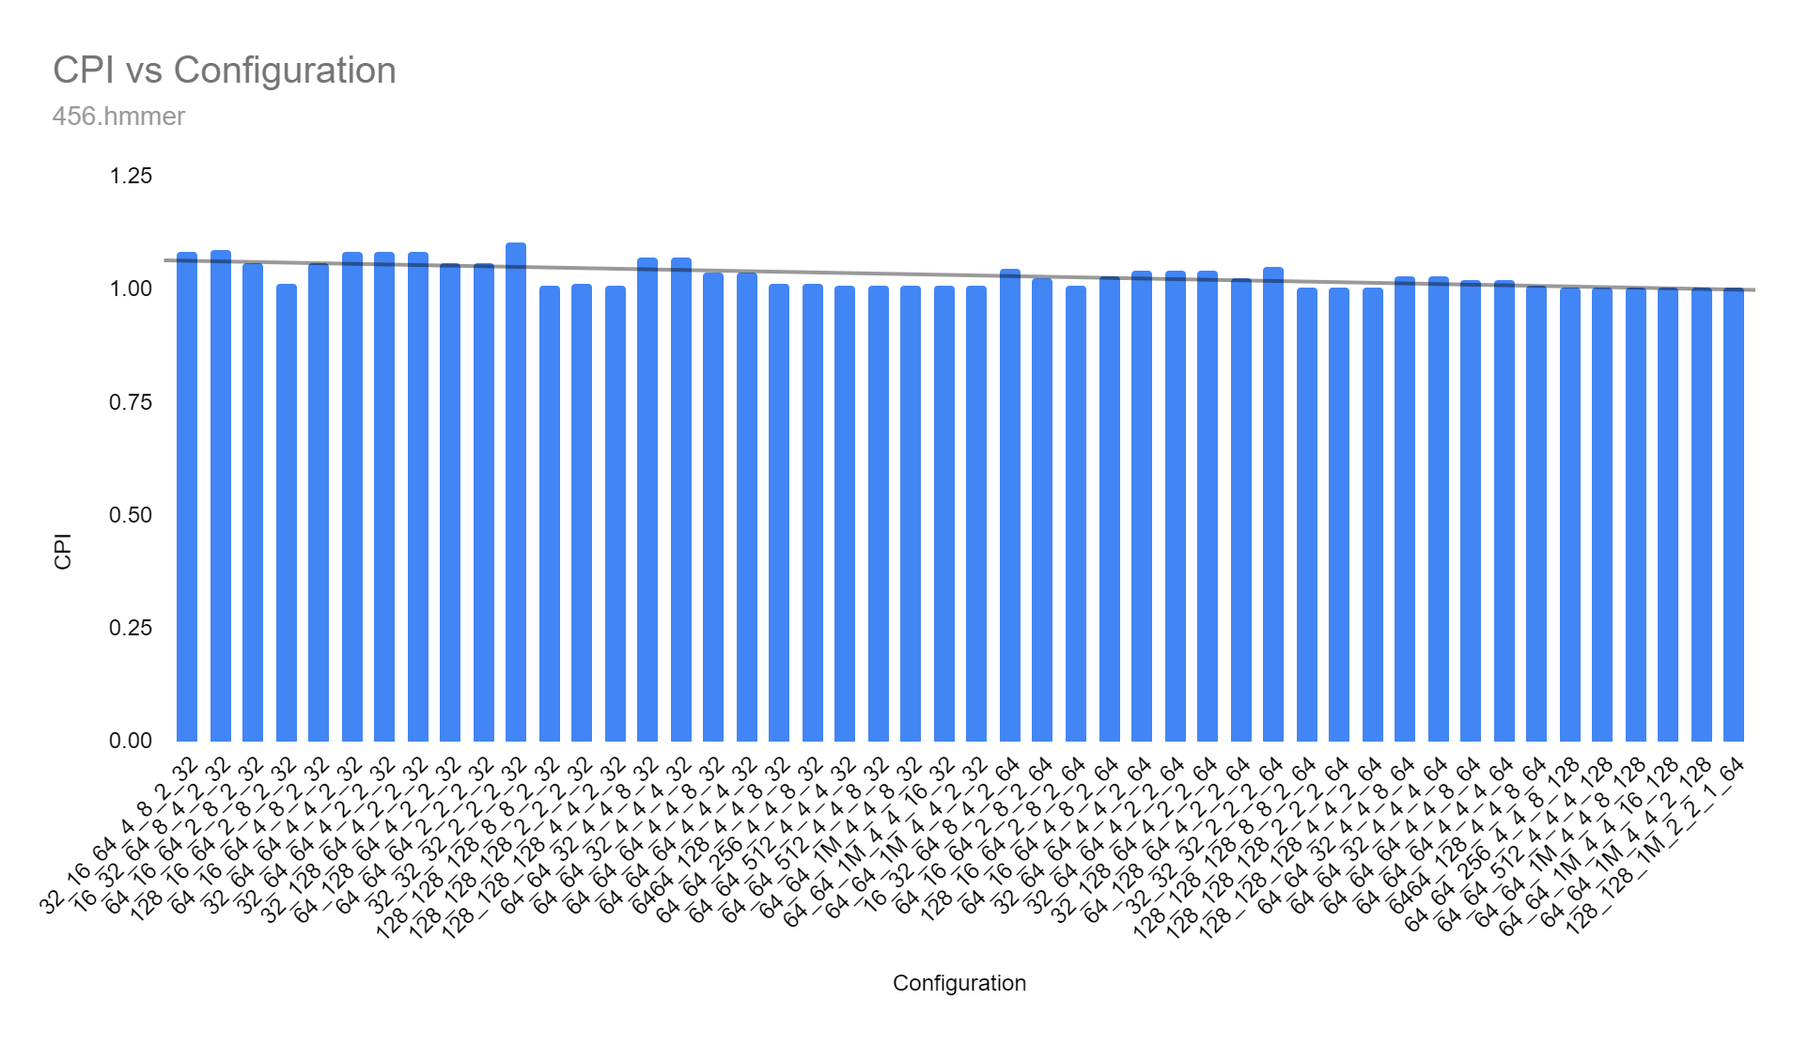
456.hmmer
Lowest CPI value-1.002855164
64kb 64kb 1mb 4 4 16 128

Slide 10
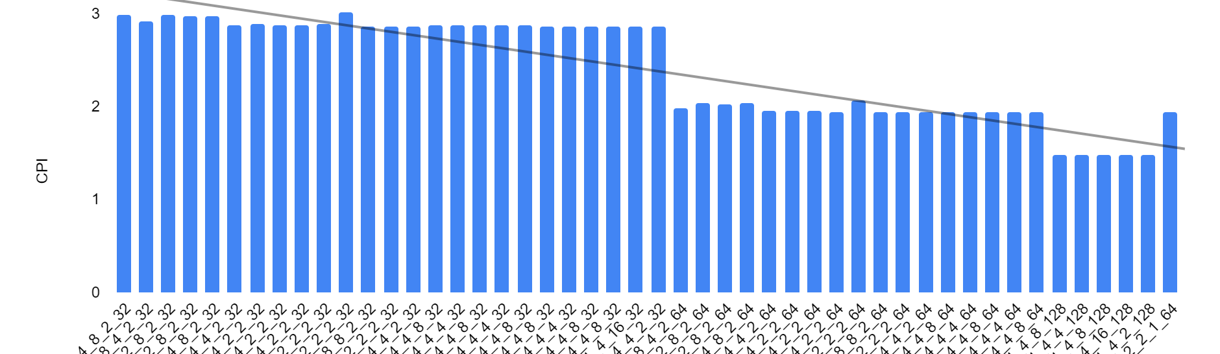
458.sjeng
Lowest CPI value-1.476798356
64kb 64kb 1mb 4 4 16 128

Slide 11
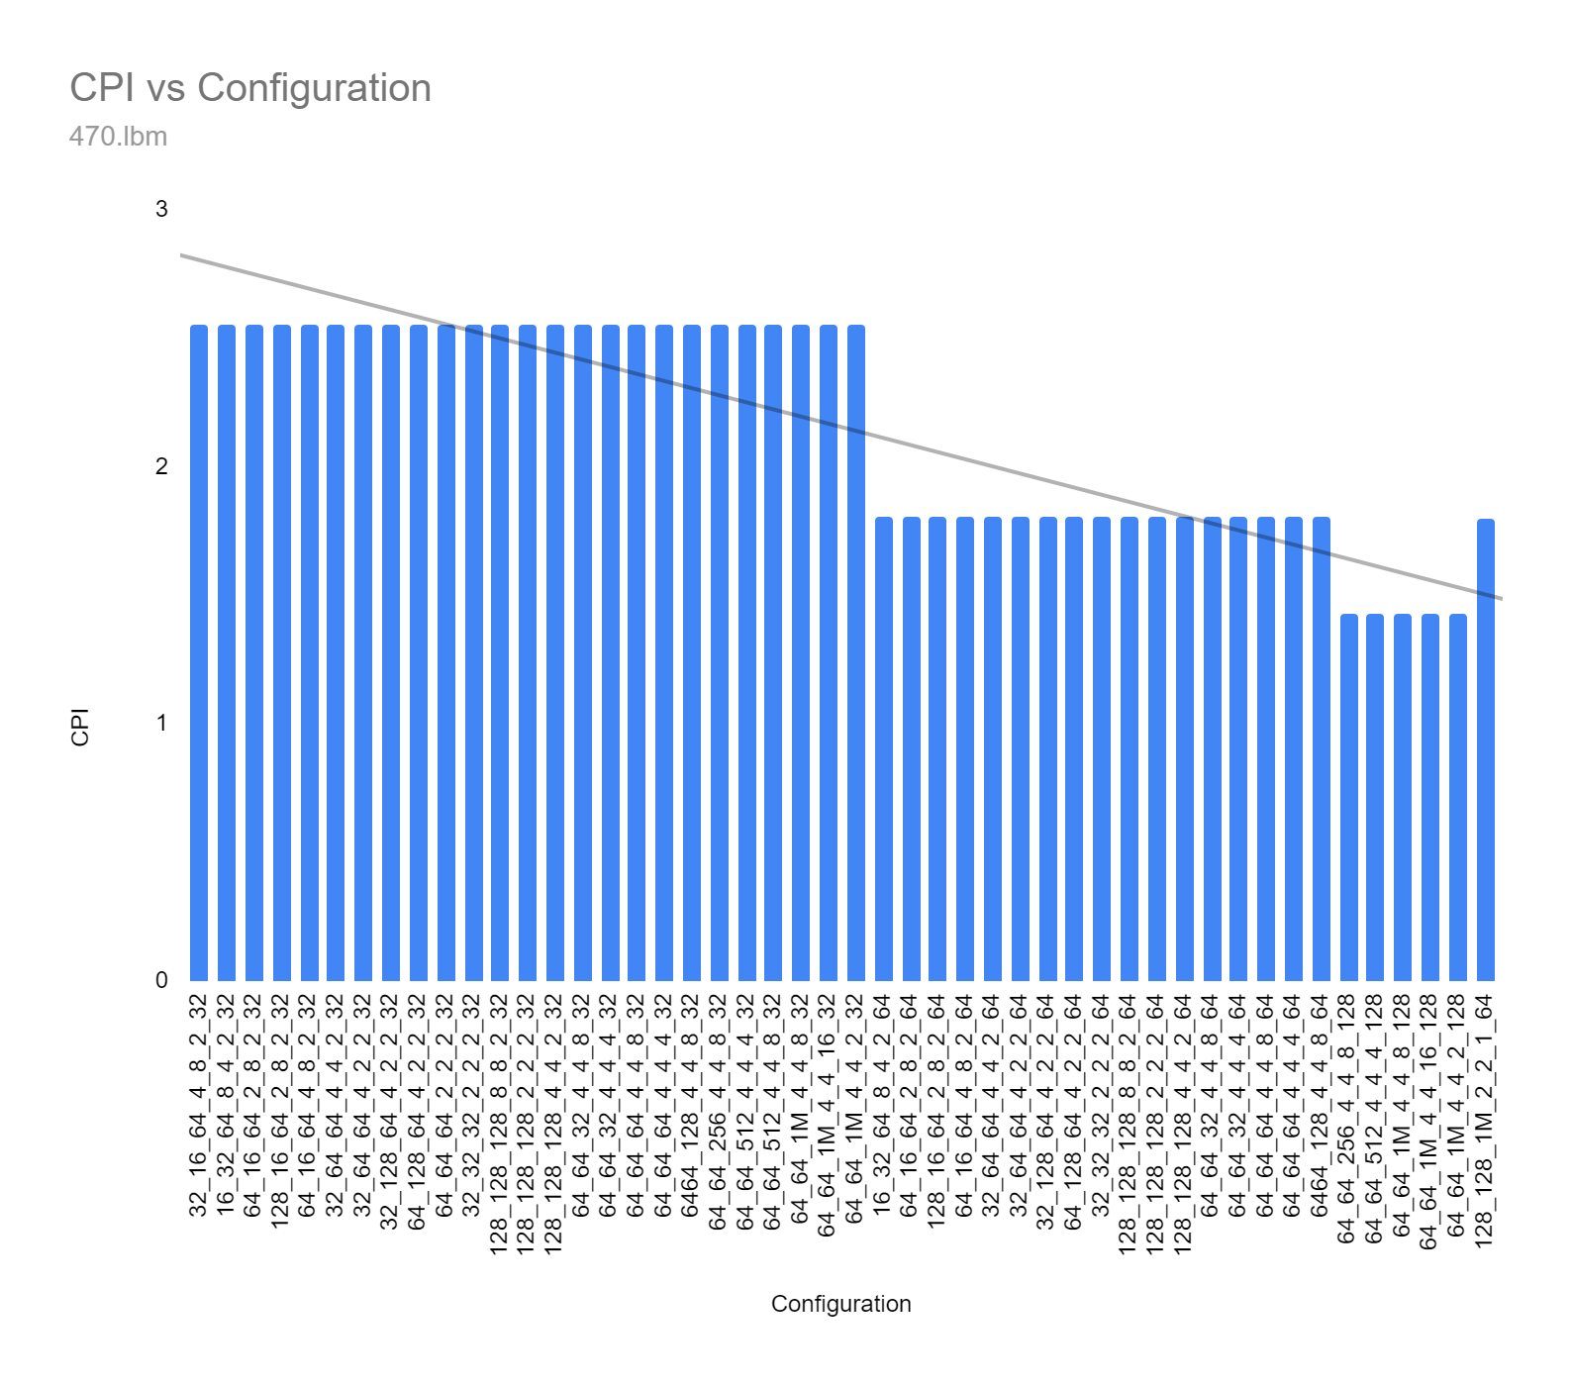
470.lbm
Lowest CPI value-1.425420688
64kb 64kb 1mb 4 4 16 128

Slide 12
COST FUNCTION

Slide 13
L1 cache(cost) > L2 cache
increase in associativity increases the cost due to additional hardware requirements (area overhead)
Cache block size also increase the cost due to additional computational resources are required

Slide 14
Assumptions-
50 % increase in cost with increase in set associativity
cost of L2 is half the cost of L1 cache cost
increase in block size increases the cost by 20%
Standard L1 cache cost X dollars for each 2 kb size

Slide 15
L1 cache
If we consider cost of the standard increase of 2kb size is x
DL1s=Data L1 cache size CBS->cache block size
IL1s=Inst L1 cache size DL1_{sa}->data cache set associativity
IL1_{sa}=IL1 set associativity
L1 Cost = ((1.2)^{log}₂^{(CBS)} )*( (X)log₂(DL1s)*(1.5)^{(log}₂^{(DL1}_{as}⁾⁾)+ (X)log₂(IL1s)*(1.5)^{(log}₂^{(IL1}_{as}⁾⁾))
cost factor due to increase in cbs Data L1 Instruction L1
Since data cache and instruction cache are different, area overhead adds to the cost each time(50% every time set associativity doubles)
And cache block size increase the cost increases by 20%
Set associativity

Slide 16
L2 cache-
If we consider cost of the standard increase of 2kb size is x/2(l1 is costly than l2)
L2s=L2 cache size
L2_{sa}=L2 set associativity
L2 Cost = ((1.2) ^{log}₂^{(CBS)} )*( (X/2)log₂(L2s)*(1.5)^{(log}₂^{(L2}_{as}⁾))
Cost factor due to
increase in cbs
Total Cost= ((1.2)^{log}₂^{(CBS)} )*( (X)log₂(DL1s)*(1.5)^{(log}₂^{(DL1}_{as}⁾⁾)+ (X)log₂(IL1s)*(1.5)^{(log}₂^{(IL1}_{as}⁾⁾) +(X/2)log₂(L2s)*(1.5)^{(log}₂^{(L2}_{as}⁾))
Cost of each configuration is calculated in the data sheet(excel sheet)
Set associativity increase

Slide 17
EVALUATION FUNCTION

Slide 18
Considering-
Cost is also an important parameters that have to considered while design, as best possible configuration may not be best affordable.
Lower the cpi, better the performance and thereby the combination of configuration parameters

Slide 19
Let’s consider Evaluation function,
EF= (1/cost)(1/CPI)
=(1/cost*cpi)
Higher the value of EF, configuration can be considered optimal for benchmark, because 1/cost is maximum when the cost is minimum, and 1/CPI is maximum when the CPI is minimum, hence we can safely consider the evaluation function for best optimal design with respect to cost

Slide 20
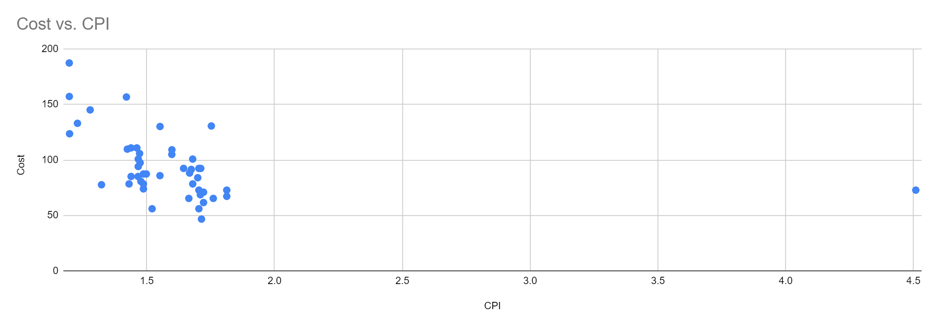
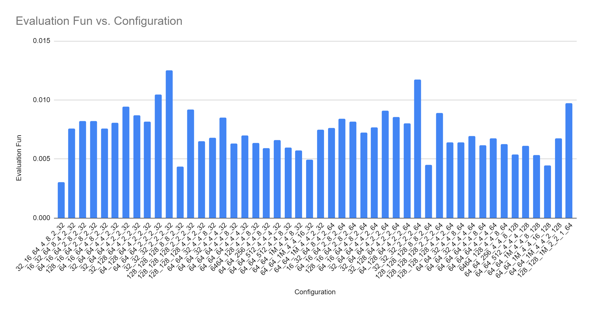
Optimal configurations of each benchmark with respect to cost can be identified from the spreadsheet attached.
1) 401.bzip2
32kB_32kB_32kB_2_2_2_32
Eval_func_value = 0.01250515669 (highest among all configurations)

Slide 21
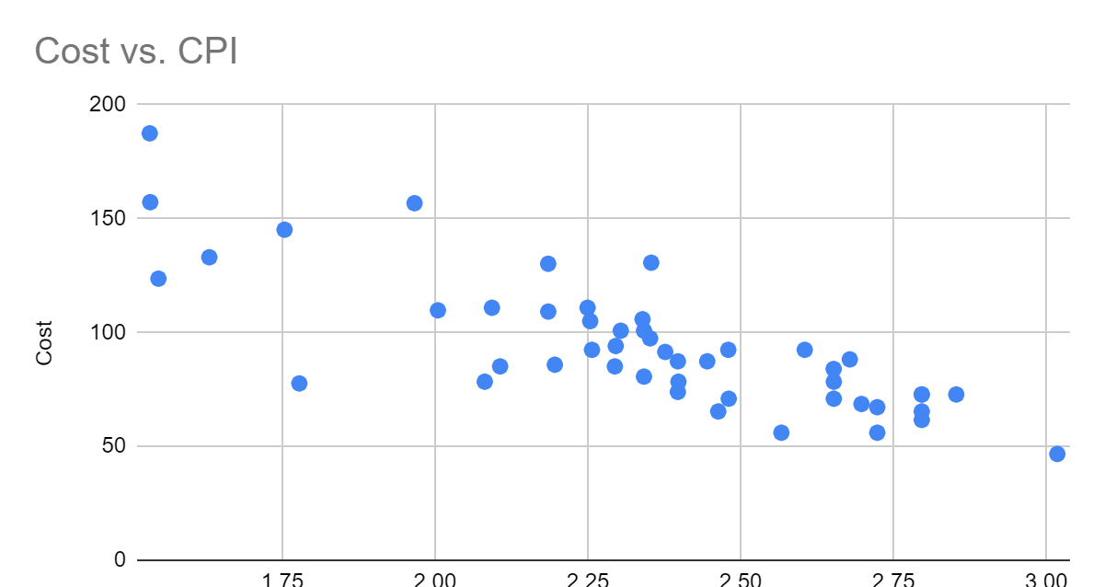
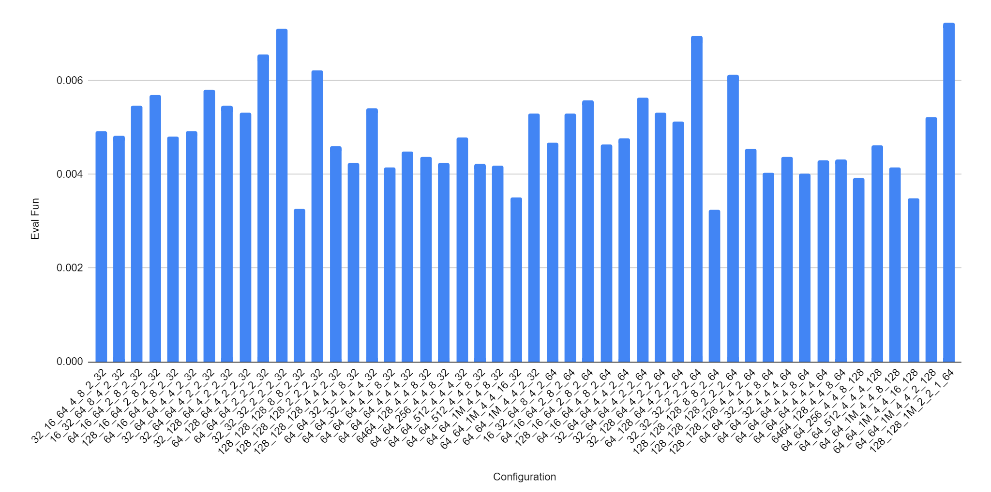
2) 429.mcf
128kB_128kB_1M_2_2_1_64
Eval_func_value = 0.00724475654

Slide 22
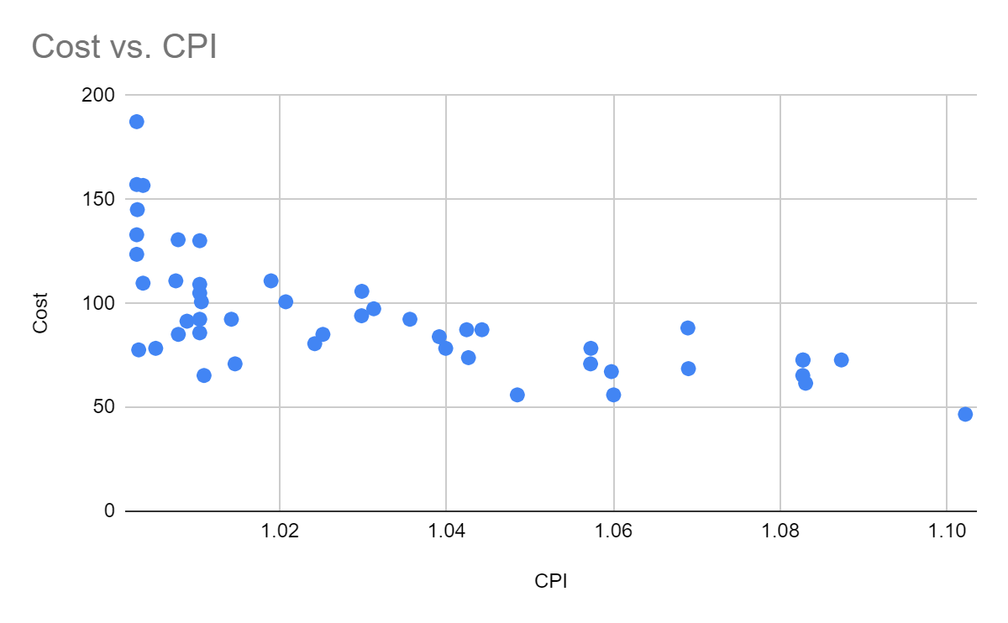
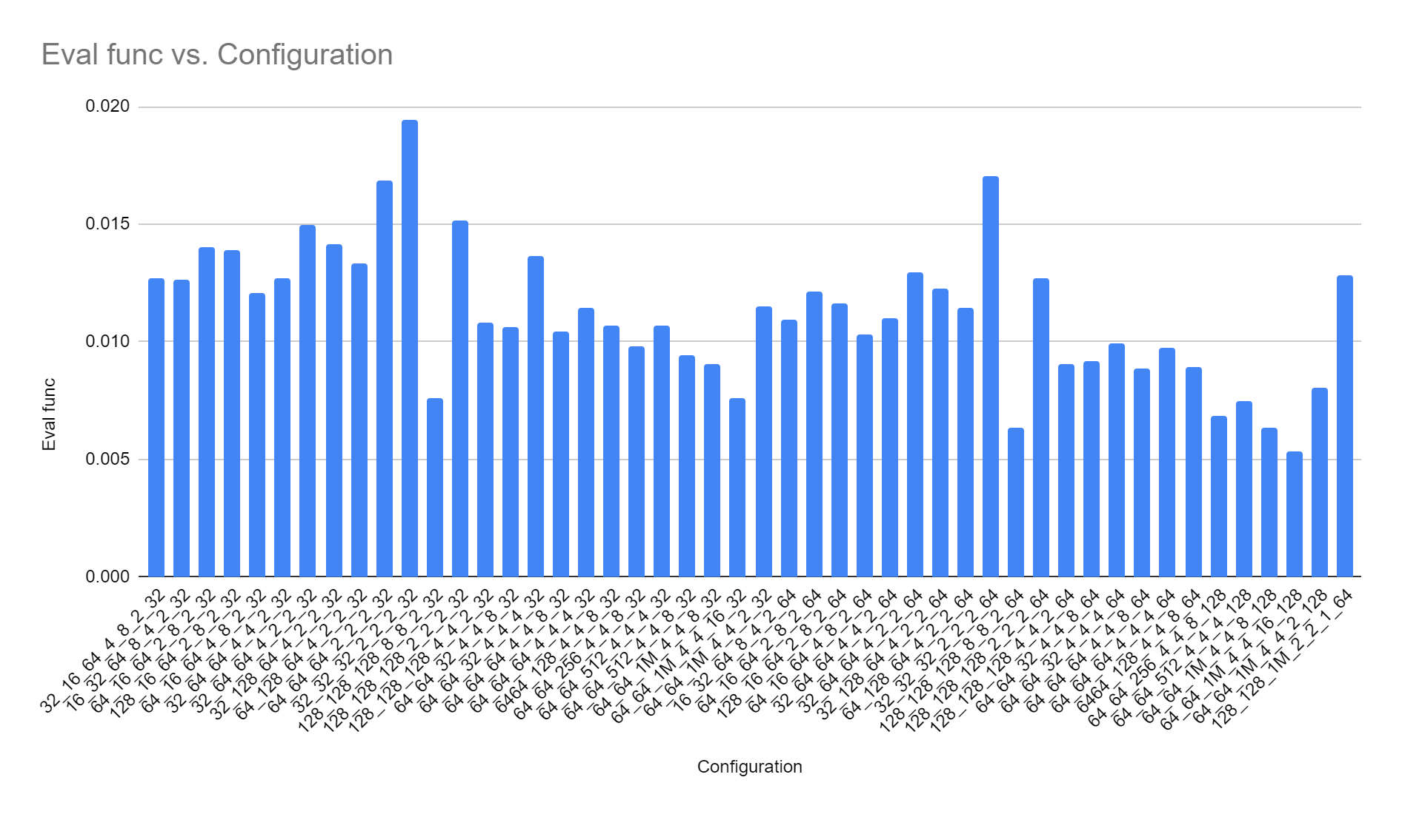
3) 456.hmmer→
32kB_32kB_32kB_2_2_2_32
Eval_func_value = 0.01944569338

Slide 23
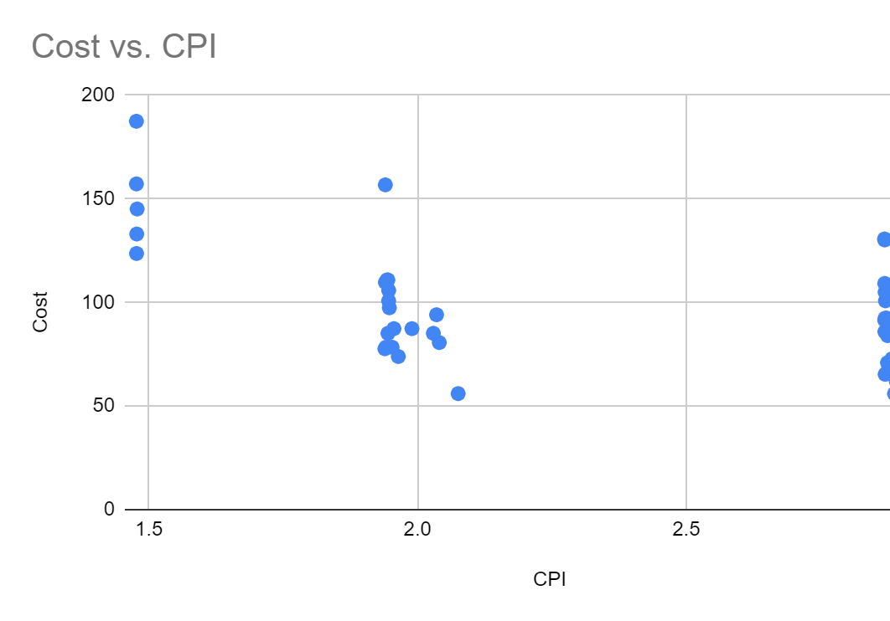
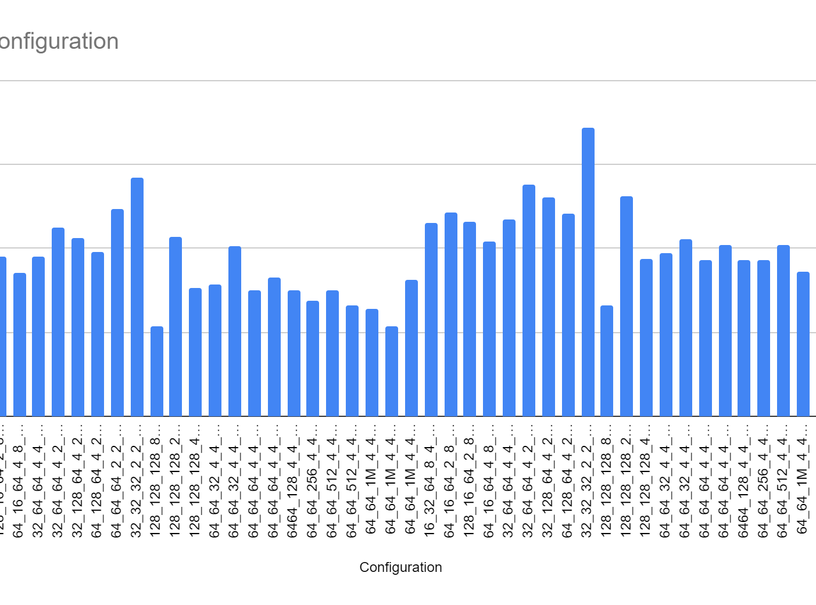
4) 458.sjeng→
32kB_32kB_32kB_2_2_2_64
Eval_func_value=0.008605639679

Slide 24
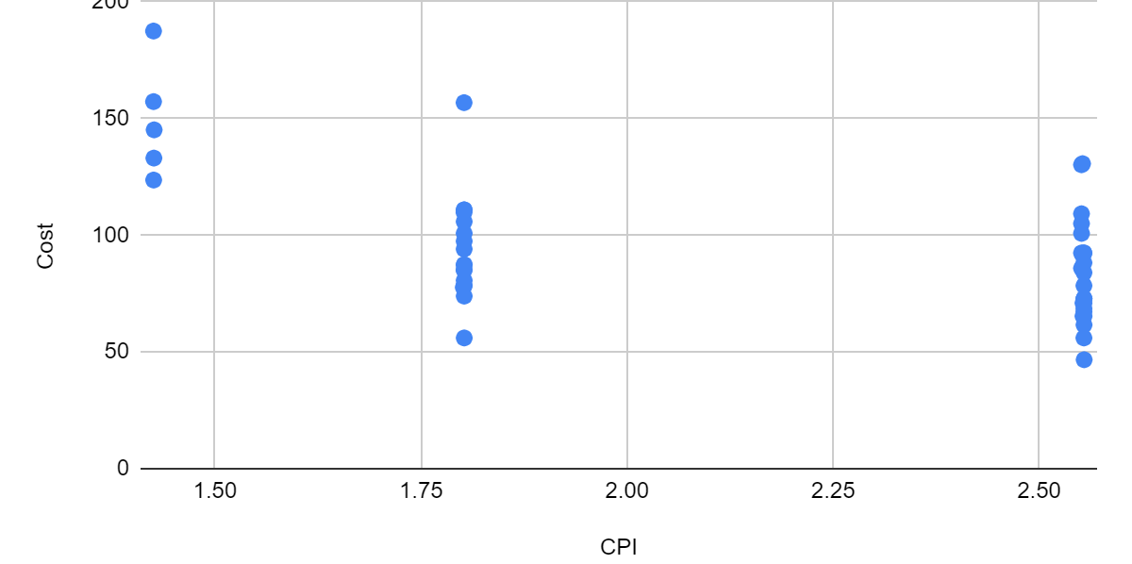
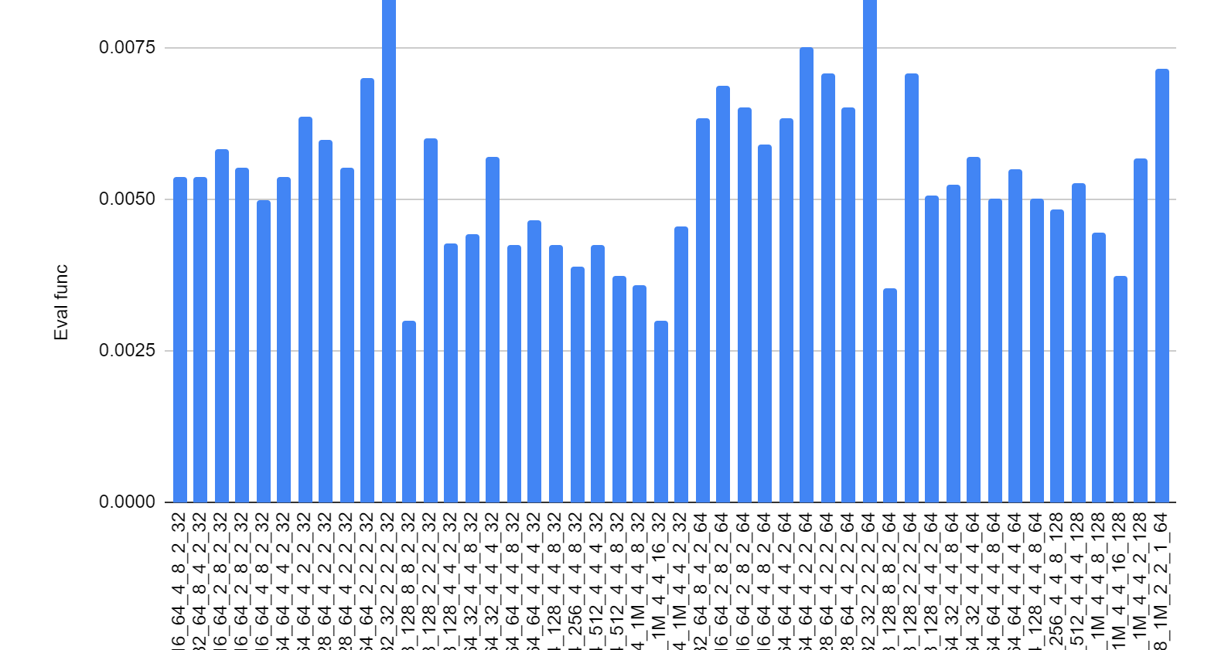
5) 470.lbm→
32kB_32kB_32kB_2_2_2_64
Eval_func_value = 0.009909649187

Slide 25
Thank you

